Slide 1
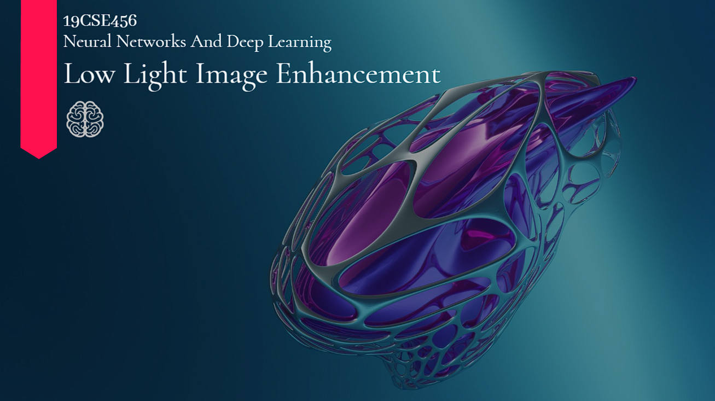
Group - 5
Ajay Raj M - CB.EN.U4CSE21004
Arjun P - CB.EN.U4CSE21007
Hariharan A - CB.EN.U4CSE21021
Rohith M - CB.EN.U4CSE21048
R Kaviswar - CB.EN.U4CSE21345

Slide 2
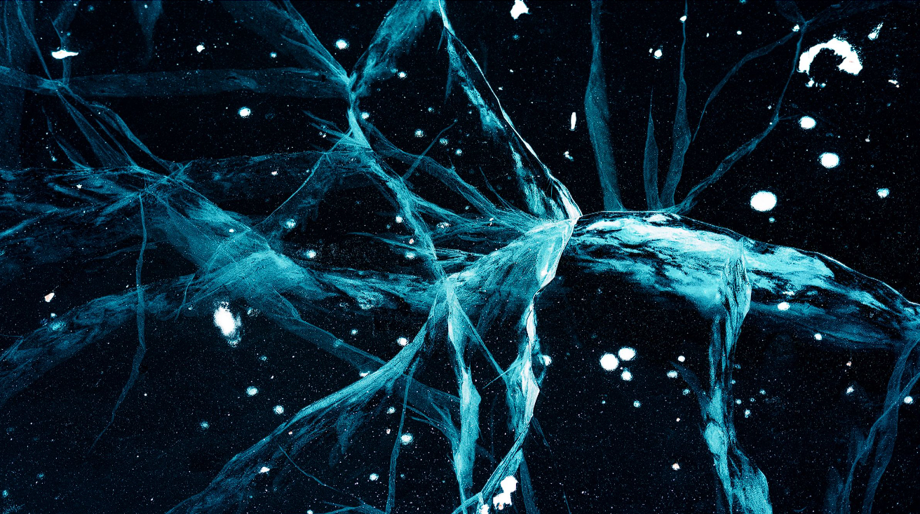
INTRODUCTION

Slide 3
INTRODUCTION
In the mysterious realm of subdued illumination, images often emerge as enigmatic and grainy, casting a veil over intricate details and complicating tasks like image recognition. This challenge pervades diverse domains, from security cameras and medical imaging to the realm of personal photography.
Our project embarks on a transformative journey, aiming to unveil a neural network model adept at breathing new life into low-light images, transcending the boundaries of visual enhancement.

Slide 4
DATASET

Slide 5
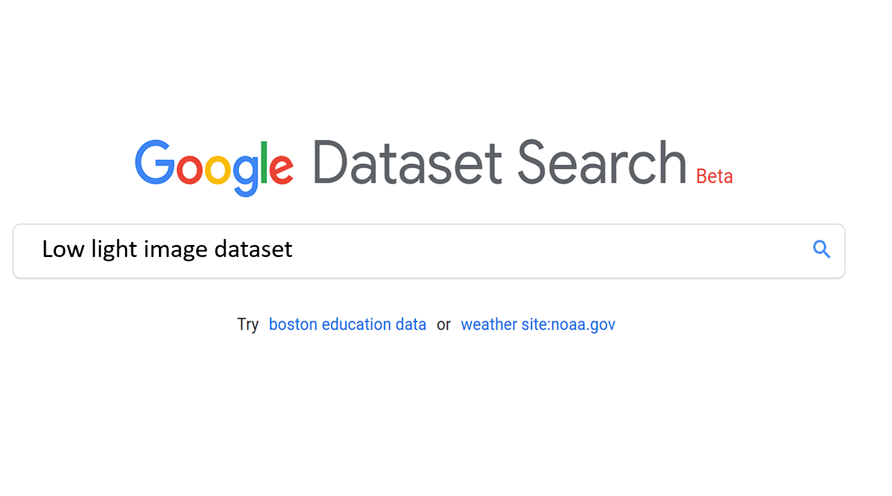
Result
https://www.kaggle.com/datasets/soumikrakshit/lol-dataset/

Slide 6
METHODOLOGY

Slide 7
METHODOLOGY
We addressed the issue of improving low-light images by harnessing the advanced capabilities of deep learning. Utilizing convolutional neural networks (CNNs), our model acquired the ability to understand the complexities present in low-light images, revealing underlying patterns and connections among pixels. Through thorough training on an extensive dataset containing pairs of low-light and corresponding well-lit images, we equipped our model to recognize the most effective transformations for enhancing brightness, contrast, and detail significantly.

Slide 8
IMPLEMENTATION

Slide 9
IMPLEMENTATION
Dataset Preparation:
Collect a large dataset of paired low-light and corresponding high- light images.
2. Pre-process the images
Network Architecture:
Choose a suitable CNN architecture for image enhancement.
Modify the architecture with specific layers and activation functions suitable for brightness and contrast enhancement.
Training:
Implement the chosen architecture using a deep learning framework
Define a loss function that measures the difference between the enhanced and corresponding high-light image
Evaluation:
Evaluate the trained model on a separate validation dataset of low-light and high-light image pairs.

Slide 10
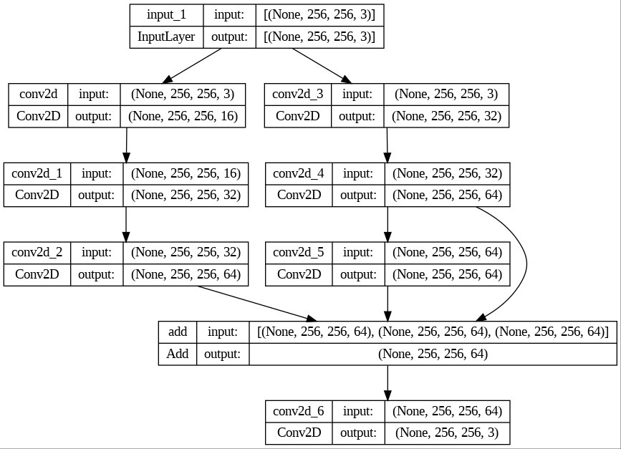

Slide 11
BASE PAPER LINKS
https://ieeexplore.ieee.org/document/9730563
https://ieeexplore.ieee.org/document/9506063
https://ieeexplore.ieee.org/document/9791380
https://arxiv.org/pdf/2207.10564.pdf

Slide 12
GITHUB LINK
https://github.com/ROHITH-M10/Low-Light-Image-Enhancement

Slide 13
GOOGLE DRIVE LINK FOR THE DATASET
https://drive.google.com/drive/folders/1SfZMQiwEWKQoLmkCpJg-MoNzGfc8KYy8

Slide 14
REFERENCE
https://github.com/jinyeying/night-enhancement/blob/main/main.py
https://github.com/dawnlh/awesome-low-light-image-enhancement
https://www.geeksforgeeks.org/image-enhancement-techniques-using-opencv-python/

Slide 15
THANK YOU

